Slide 1
Neurons
Kiran Akbar Khan

Slide 2
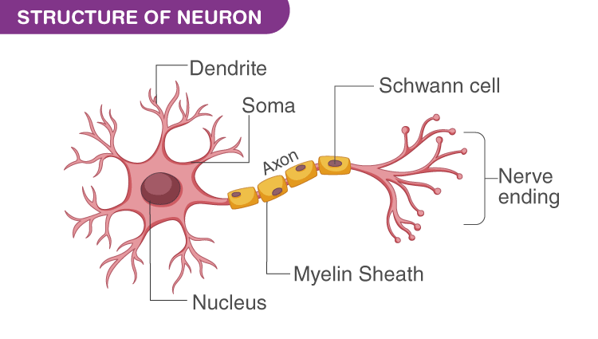
What is Neuron?
Neurons are individual cells in the nervous system that receive, integrate and transmit information.
They are the basic links that permit communication within nervous system.
The vast majority of them communicate only with other neurons.

Slide 4
Parts of Neuron
1) Dendrites:
Branch like structures of a neuron that receive messages from other neurons.

Slide 5
Parts of Neuron
2) Soma (Cell body):
Part of cell which contains the nucleus and keeps the entire cell alive and functioning.
.

Slide 6
Parts of Neuron
3) Axon:
Tube-like thin structure of a neuron that carries the neural message from the cell body to the axon terminals, for communication with other cells.

Slide 7
Parts of Neuron
4) Axon Terminals:
Enlarged ends of axonal branches of the neuron, specialized for communication between cells.

Slide 8
Parts of Neuron
5) Myelin Sheath:
Fatty substances produced by certain glial cells that coat the axon of neurons to insulate, protect and speed up neural impulse.

Slide 9
Glial Cells
Glia are cells found throughout the nervous system that provide various types of support for neurons.
Variety of functions:
Provide support for neurons to grow.
Deliver nutrients to neurons.
Produce myelin sheath to coat axons.
Clean up waste products and dead neurons.
Help maintain a state of homeostasis.

Slide 10
Potential
Resting Potential
Action Potential
State of the neuron when not firing a neural impulse.
A neuron contains charged particles called ions.
When at rest, it is negatively charges on the inside & positively charged on the outside.
When stimulated, this reverses the charge by allowing positive sodium ions to enter the cell.

Slide 11
All-or-None Law
The neural impulse is an all-or-none proposition, like firing a gun. You cant half-fire a gun. The same is true of the neuron’s firing of action potentials.
Either the neuron fires or it doesn’t, and its action potentials are the same size (Kandel, 2000).
That is weaker stimuli do not produce smaller action potentials and stronger stimuli do not evoke larger action potentials.

Slide 12
Terms
Neurotransmission: Process via which neurons use neurotransmitter to communicate with each other & with the body.
Neurotransmitter: Chemical found in the synaptic vesicles that, when released, has an effect on the next cell. OR
Chemicals released by the axonal end or terminal of a neuron to transmit the impulse to the next neuron

Slide 13
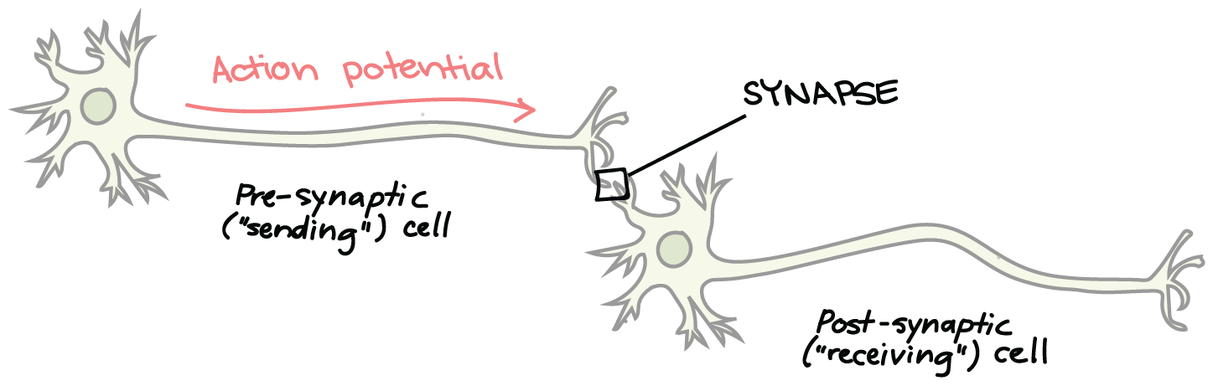
Synapses: sending messages to other cells
The nerve impulse reaches the axon terminal. Triggering the release of neurotransmitter from the synaptic vesicles.
The molecules of neurotransmitter cross the synaptic gap to fit into the receptor site that fit the shape of the molecule, opening the ion channel & allowing sodium ions to rush in.

Slide 14
Contin…..
Synaptic Gap: Microscopic fluid-filled space between the axon terminal of one cell and the dendrites or soma of the next cell.
Receptor Sites: 3-D proteins on the surface of the dendrite or certain cells of the muscles & glands, which are shaped to fit only certain neurotransmitters.

Slide 15
Neurotransmitters
Acetycholine (Ach): Released by the motor neurons controlling skeletal muscles, contributes to the regulation of attention, arousal and memory.
Disorders associated with dysregulation: Alzheimer's disease.

Slide 16
Contin……
Dopamine: contributes to control of voluntary movements and sensation of pleasure.
Disorders associated with dysregulation: Parkinsons, Schizophrenia and addictive disorders.
Serotonin: Involved in regulation of sleep and wakefulness, eating and aggression.
Disorders associated with dysregulation: Depressive disorders, obsessive compulsive disorder and eating disorders.

Slide 17
Contin……
Norepinephrine (NE): Contributes to modulation of mood and arousal.
Disorders associated with dysregulation: Depressive disorders.
GABA: Serves as widely distributed inhibitory transmitter, contributing to regulation of anxiety and sleep/arousal.
Disorders associated with dysregulation: Anxiety disorders.

Slide 18
Contin……
Glutamate: Serves as widely distributed excitatory transmitter involved in learning and memory.
Disorders associated with dysregulation: Anxiety disorders.
Endorphins: play role in pain relief and response to stress, contribute to regulation of eating behavior.

